Slide 1
Predicting the term deposition subscription

Slide 2
Business Problem:
The data is related with direct marketing campaigns of a Portuguese banking institution. The marketing campaigns were based on phone calls. Often, more than one contact to the same client was required, in order to access if the product (bank term deposit) would be ('yes') or not ('no') subscribed.
The classification goal is to predict if the client will subscribe (yes/no) a term deposit (variable y)

Slide 3
Project Architecture / Project Flow
1.Understanding Business Objective
2.Getting data set details
3.EDA:Exploratory Data Analysis
4.Model Building
5.Evaluate the model
6.Data Visualizations
7.Deployment Frame

Slide 4
Exploratory Data Analysis (EDA) and
Feature Engineering

Slide 5
Data set details
1)The dataset is having 45211 observations.
2)It is having 17 columns and 45211 rows.
3)There are no missing values in the data set
4)The data set is having both the combination of categorical values and numeric values.So, we need to convert categorical values to numeric
5)There are no duplicate values in the data set.
6)The target column is the dependent variable with values yes or no
7)The top 5 rows of the data set is shown below.
7)Following are the columns in the data set:
Dependent Variable : 'Target', ‘
Independent Variables: age', 'job', 'marital', 'education', 'default', 'balance', 'housing', 'loan', 'contact’, 'day', 'month', 'duration', 'campaign', 'pdays', 'previous', 'poutcome'

Slide 6
Data set details
The data set details are as follows:
1)age (numeric)
2)job : type of job (categorical: 'admin.','blue-collar','entrepreneur','housemaid','management','retired','self employed','services','student','technician','unemployed','unknown’)
3)marital : marital status (categorical: 'divorced','married','single','unknown'; note: 'divorced' means
4)education : (categorical: 'primary', 'secondary', 'tertiary', 'unknown’)
5)default: has credit in default? (categorical: 'no','yes','unknown’)
6)housing: has housing loan? (categorical: 'no','yes','unknown’)
7)balance : average yearly balance, in euros (numeric)
8)loan: has personal loan? (categorical: 'no','yes','unknown’)
9)contact: contact communication type (categorical: 'cellular','telephone', 'unknown’)
10)month: last contact month of year (categorical: 'jan', 'feb', 'mar', ..., 'nov', 'dec’)
11)day: last contact day of the month (numeric 1 -31)
12)duration: last contact duration, in seconds (numeric).
13)campaign: number of contacts performed during this campaign and for this client (numeric, includes last contact)
14)pdays: number of days that passed by after the client was last contacted from a previous campaign (numeric; 999 means client was not previously contacted)
15)previous: number of contacts performed before this campaign and for this client (numeric)
16)poutcome: outcome of the previous marketing campaign (categorical: 'failure','other', 'unknown', 'success’)
17)target - has the client subscribed a term deposit? (binary: 'yes','no')

Slide 7
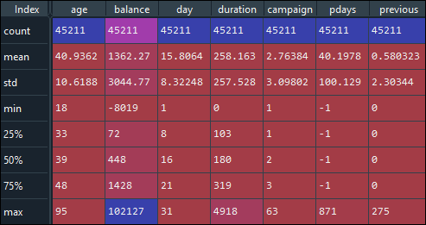
Data set details
Above table show the statistical analysis of the data set. It shows mean,median,mode,max values for the numeric feature.
The target column is the dependent variable with values yes or no. The target value count is (for no:39922 yes :5289
Left side table shows that data set down have any null values

Slide 8
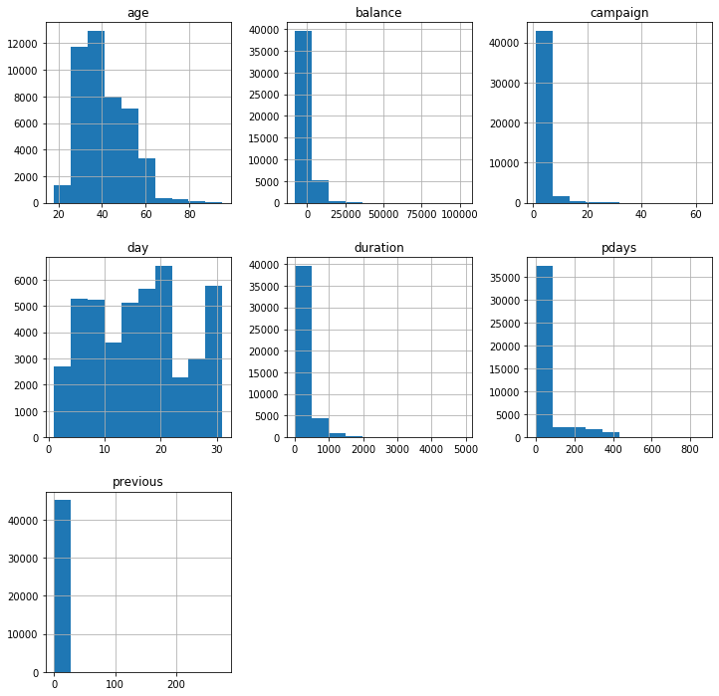
Data visualization :
1)The above plot is the histogram plot for the numeric features in the data set. We have job','marital','education','default','housing','loan','contact','month','poutcome’ these are in categorical values we need to convert some variable to dummy variable. A histogram makes it easier to identify different data, the frequency of its occurrence and categories

Slide 9
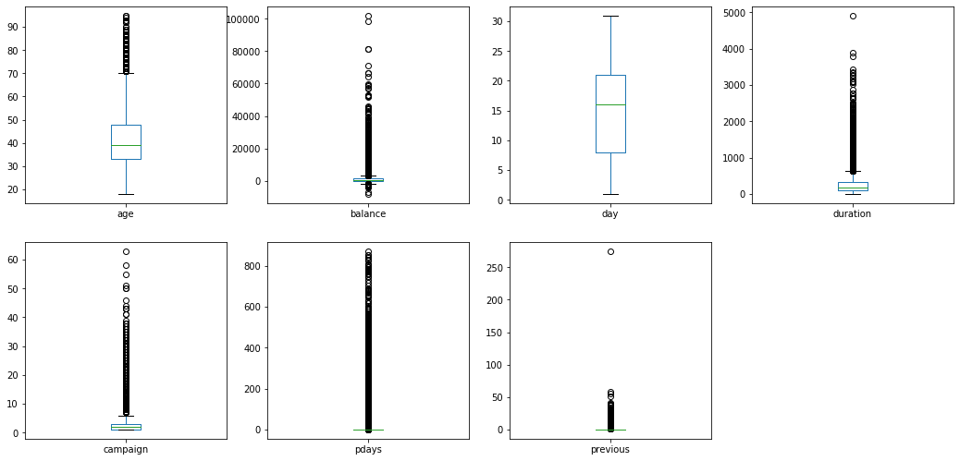
Data visualization :
1)The above plot is the box plot for the numeric features in the data set. The main advantage of boxplot is it shows outliers. An outlier is a data point that differs significantly from other observations.

Slide 10
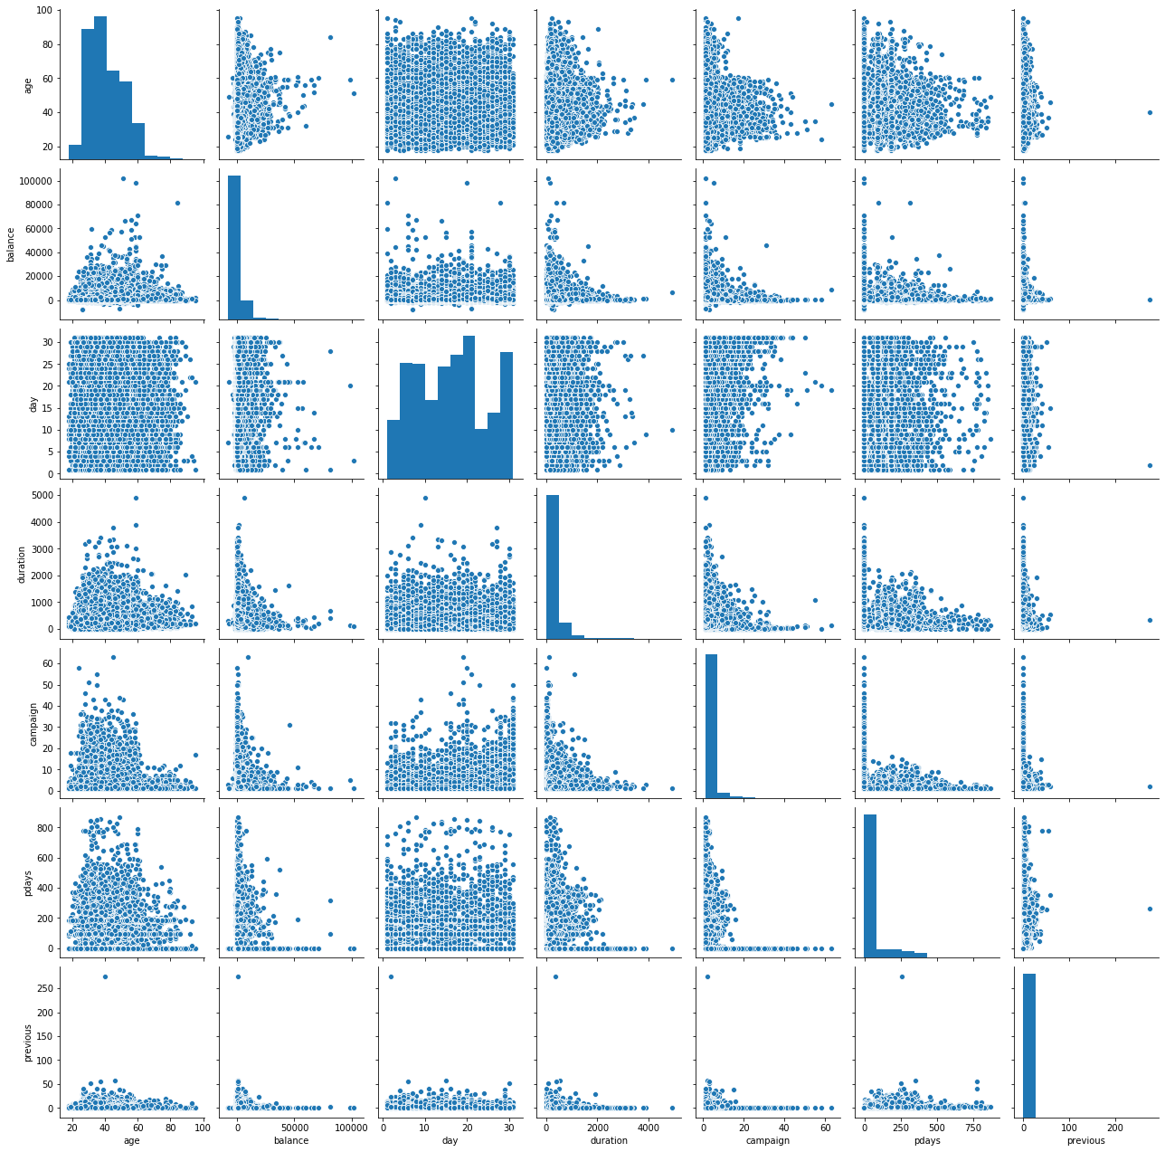
Data visualization :
1)The above plot represents the scatter plot for numeric features in the data set. A pairplot plot a pairwise relationships in a dataset. A “pairplot” is also known as a scatterplot, in which one variable in the same data row is matched with another variable's value,.

Slide 11
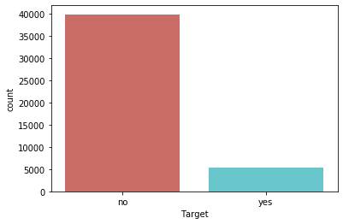
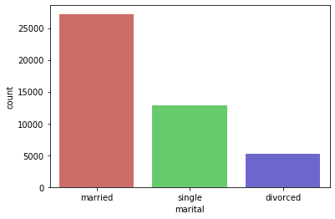
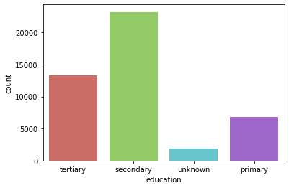
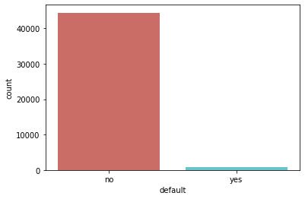
Data visualization :
We have few features which are categorical so we have to convert them to numeric. job','marital','education','default','housing','loan','contact','month','poutcome’ these are in categorical values we need to convert some variable to dummy variable. Below are the count plots for categorical features which we can get insights from it.

Slide 12
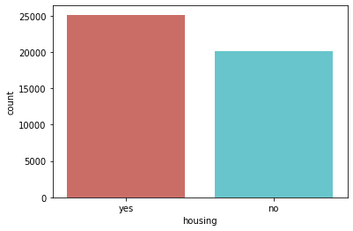
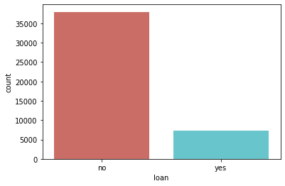
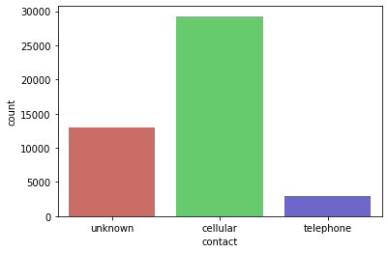
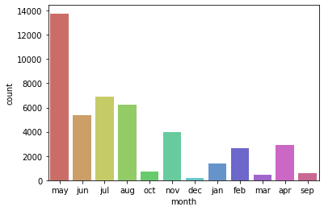
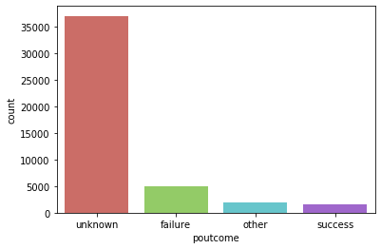
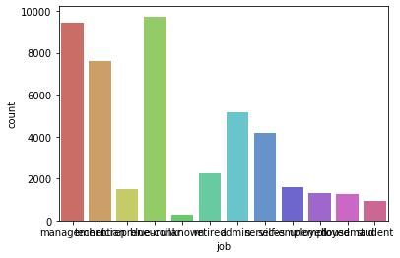
Data visualization :

Slide 13
Model Building

Slide 14
Model building Results before SMOTE:
Model Used | num | Precision | Recall | f1-score | Number of errors | Testing_ Accuracy | Training_ Accuracy
Logistic Regression | no | 0.92 | 0.98 | 0.95 | 1288 | 0.9 | 0.9
 | yes | 0.67 | 0.35 | 0.46
Decision Tree Classifier | no | 0.93 | 0.93 | 0.93 | 1673 | 0.87 | 1
 | yes | 0.47 | 0.48 | 0.48
Random Forest Classifier | no | 0.92 | 0.97 | 0.95 | 1265 | 0.9 | 0.99
 | yes | 0.67 | 0.39 | 0.49
Extra tree Classifier | no | 0.92 | 0.97 | 0.95 | 1330 | 0.9 | 1
 | yes | 0.64 | 0.35 | 0.45
SVM Classifier | no | 0.92 | 0.98 | 0.95 | 1316 | 0.9 | 0.91
 | yes | 0.67 | 0.32 | 0.44
Neural Networks | no | 0.93 | 0.96 | 0.95 | 1324 | 0.9 | 0.9
 | yes | 0.6 | 0.48 | 0.54
Bagging Classifier | no | 0.92 | 0.97 | 0.95 | 1329 | 0.9 | 0.99
 | yes | 0.62 | 0.4 | 0.49
Catboost Classifier | no | 0.93 | 0.97 | 0.95 | 1231 | 0.9 | 0.94
 | yes | 0.65 | 0.48 | 0.55
XGB Classifier | no | 0.93 | 0.96 | 0.95 | 1261 | 0.9 | 0.95
 | yes | 0.63 | 0.48 | 0.54
Linear SVM Classifier | no | 0.92 | 0.98 | 0.95 | 1312 | 0.9 | 0.89
 | yes | 0.68 | 0.31 | 0.43
Observation: From the results off all the classification models we can infer that there is a class imbalance problem in the data set.
How to solve Class Imbalance?
By using SMOTE technique we are trying to solve class imbalance problem
SMOTE : stands for Synthetic Minority Oversampling Technique. This is a statistical technique for increasing the number of cases in your dataset in a balanced way. The module works by generating new instances from existing minority cases that you supply as input.

Slide 15
Model building Results after SMOTE:
Model Used | num | Precision | Recall | f1-score | Number of errors | Testing_Accuracy | Training_Accuracy
Logistic Regression | no | 0.92 | 0.98 | 0.95 | 1288 | 0.9 | 0.9
 | yes | 0.67 | 0.35 | 0.46
Decision Tree Classifier | no | 0.93 | 0.93 | 0.93 | 1673 | 0.87 | 1
 | yes | 0.47 | 0.48 | 0.48
Random Forest Classifier | no | 0.92 | 0.97 | 0.95 | 1265 | 0.9 | 0.99
 | yes | 0.67 | 0.39 | 0.49
Extra tree Classifier | no | 0.92 | 0.97 | 0.95 | 1330 | 0.9 | 1
 | yes | 0.64 | 0.35 | 0.45
SVM Classifier | no | 0.92 | 0.98 | 0.95 | 1316 | 0.9 | 0.91
 | yes | 0.67 | 0.32 | 0.44
Neural Networks | no | 0.93 | 0.96 | 0.95 | 1324 | 0.9 | 0.9
 | yes | 0.6 | 0.48 | 0.54
Bagging Classifier | no | 0.92 | 0.97 | 0.95 | 1329 | 0.9 | 0.99
 | yes | 0.62 | 0.4 | 0.49
Catboost Classifier | no | 0.93 | 0.97 | 0.95 | 1231 | 0.9 | 0.94
 | yes | 0.65 | 0.48 | 0.55
XGB Classifier | no | 0.93 | 0.96 | 0.95 | 1261 | 0.9 | 0.95
 | yes | 0.63 | 0.48 | 0.54
Linear SVM Classifier | no | 0.92 | 0.98 | 0.95 | 1312 | 0.9 | 0.89
 | yes | 0.68 | 0.31 | 0.43

Slide 16
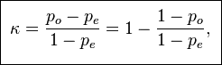
cohen_kappa_score:
Before SMOTE:
After SMOTE:
Model Used | cohen_kappa_score
Logistic Regression | 0.41
Decision Tree Classifier | 0.4
Random Forest Classifier | 0.44
Extra tree Classifier | 0.4
SVM Classifier | 0.38
Neural Networks | 0.48
Bagging Classifier | 0.43
Catboost Classifier | 0.5
XGB Classifier | 0.49
Linear SVM Classifier | 0.38
Model Used | cohen_kappa_score
Logistic Regression | 0.47
Decision Tree Classifier | 0.4
Random Forest Classifier | 0.511
Extra tree Classifier | 0.44
SVM Classifier | 0.5
Neural Networks | 0.49
Bagging Classifier | 0.48
Catboost Classifier | 0.54
XGB Classifier | 0.53
Linear SVM Classifier | 0.47
Cohen_kappa_Score:
1)Cohen’s Kappa statistic is a very useful, but under-utilised, metric. Sometimes in machine learning we are faced with a multi-class classification problem. In those cases, measures such as the accuracy, or precision/recall do not provide the complete picture of the performance of our classifier. In some other cases we might face a problem with imbalanced classes(Majority class and minority class problems)
2) Cohen’s kappa statistic is a very good measure that can handle very well both multi-class and imbalanced class problems.
3) Cohen’s kappa is given by the formula:
Where : where po is the observed agreement, and pe is the expected agreement.

Slide 17
Evaluation step:
1)From all model building results we can conclude that cohen_kappa_Score for Catboost classifier model is 0.54 which is moderate and good compared to other models ,Number of predicting errors = 1231 which is less compared to other models. Testing Accuracy is high 90 %. So the final model is Catboost classifier.
2)Precision = Quality of prediction .
3)Recall = Measurement of coverage.
4) Cohen_kappa_Score : Cohen’s kappa is always less than or equal to 1. Values of 0 or less, indicate that the classifier is useless. There is no standardized way to interpret its values. Landis and Koch (1977) provide a way to characterize values. According to their scheme a value < 0 is indicating no agreement , 0–0.20 as slight, 0.21–0.40 as fair, 0.41–0.60 as moderate, 0.61–0.80 as substantial, and 0.81–1 as almost perfect agreement.

Slide 18
Model Deployment using

Slide 19
Model Deployment
The Model Deployed is Catboost Classifier
For deployment we have created files like app.py and Model.pkl.
CatboostClassifier(Higher Accuracy Model) saved as to Model.pkl.
And app.py is the Flask deployment code.

Slide 20
Deployment Using flask
Flask File Creation:
Import Flask from flask module
Create an instance of the Flask class
We use @app.route(‘/’) to execute home function and @app.route(‘/predict’, methods=[POST]) to execute predict function
Using which gives results page for this use index.html
After execute whole deployment code it gives link like http://127.0.0:5000 run this link to get results.

Slide 21

Results:

Slide 22
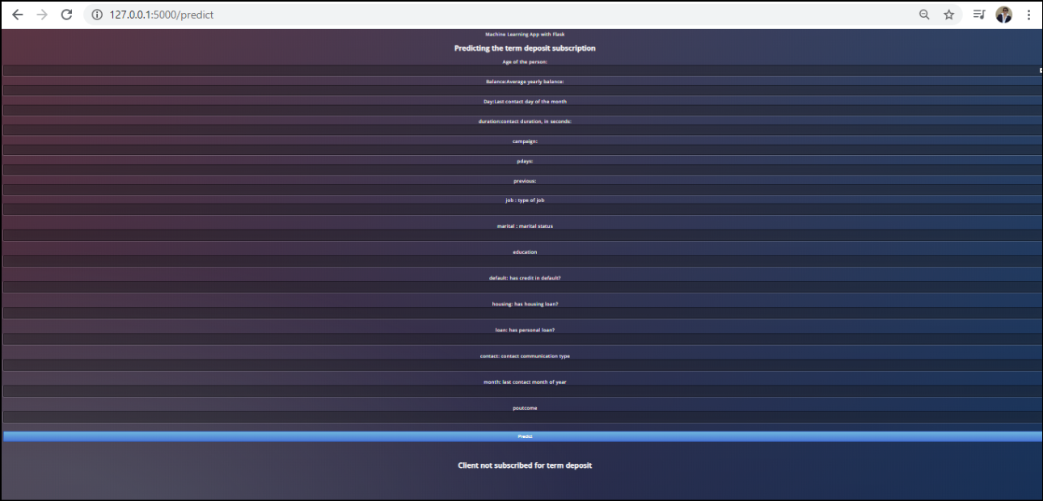
Results:

Slide 23
Thank you

